Slide 1


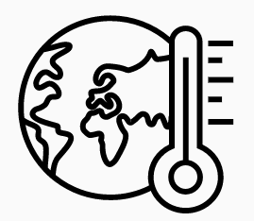
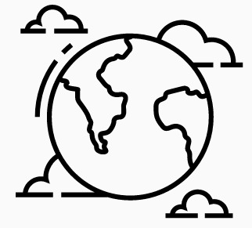

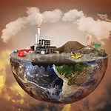


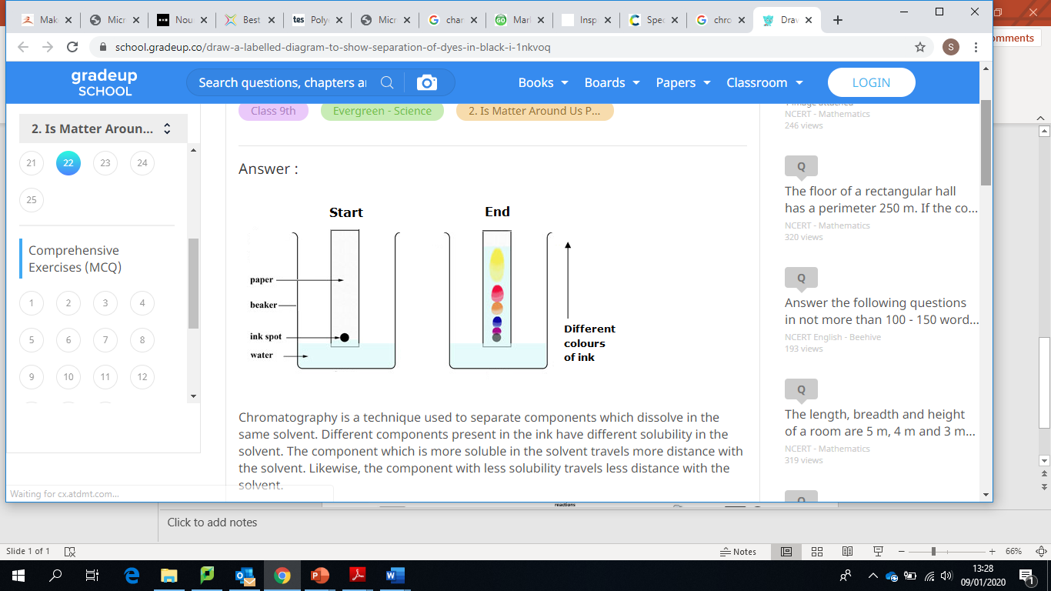


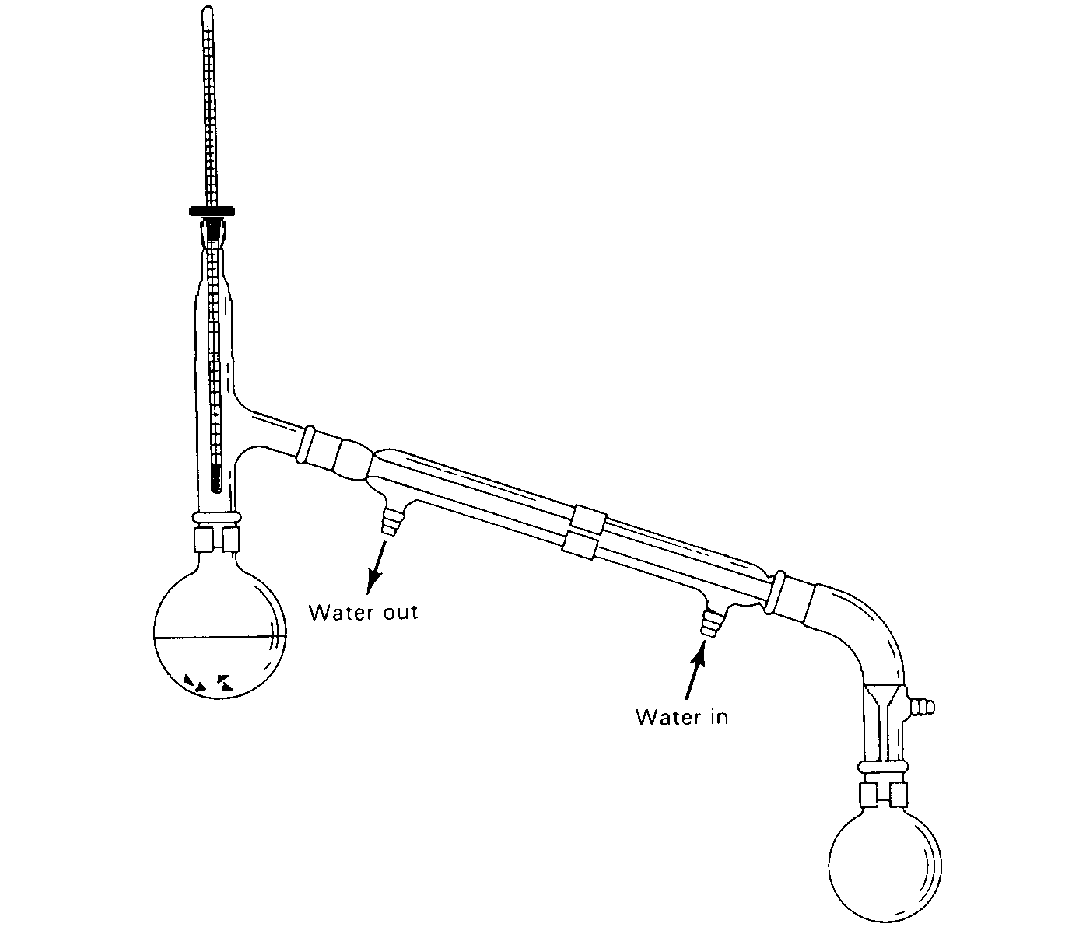
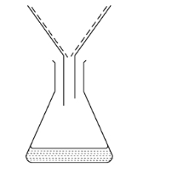

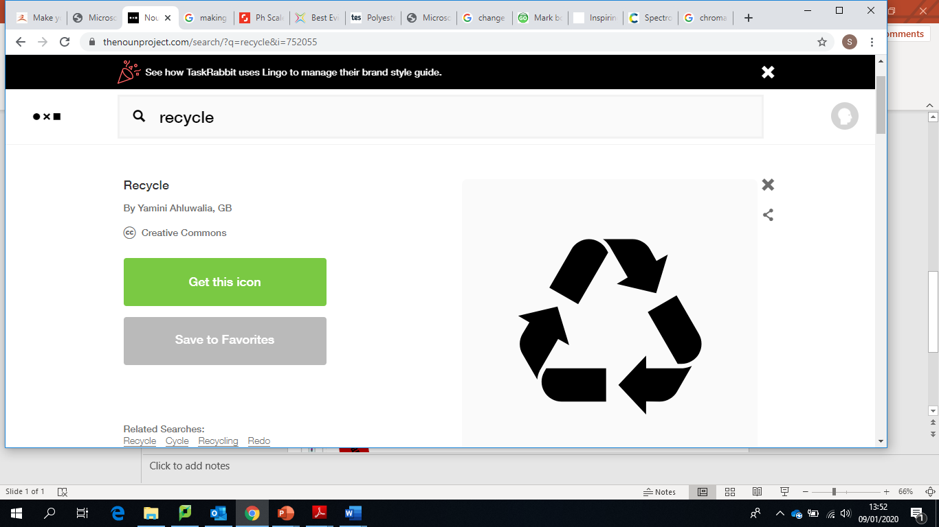
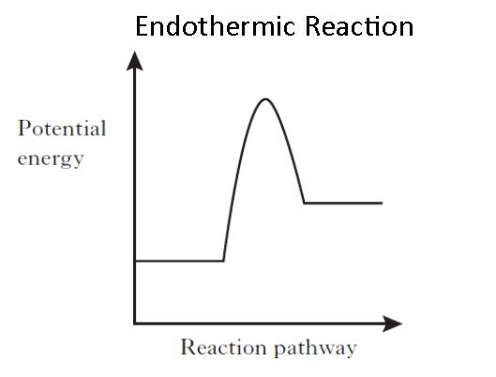
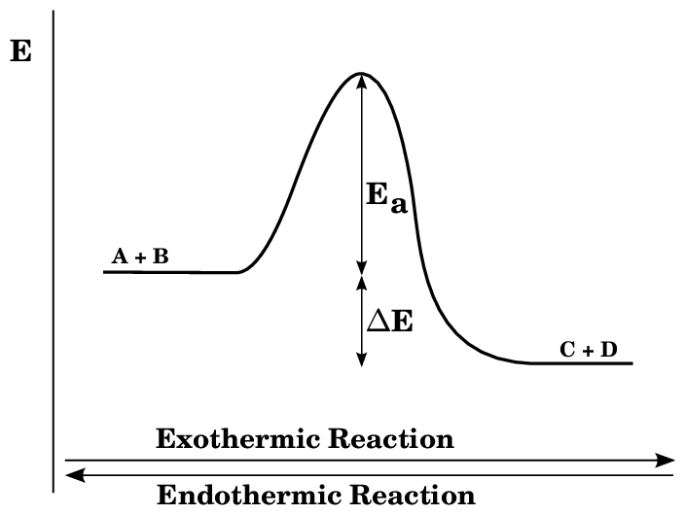
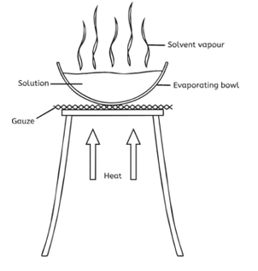
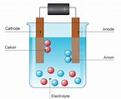

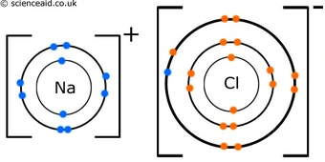
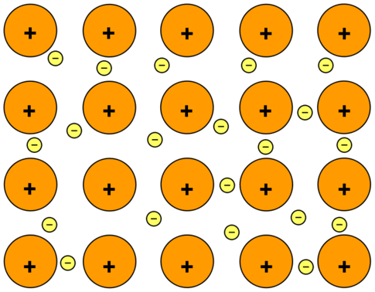
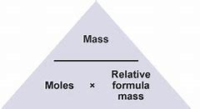
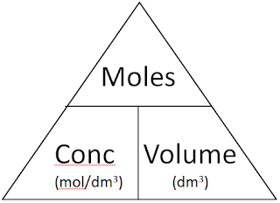
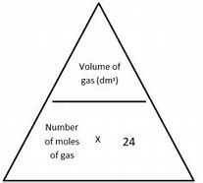
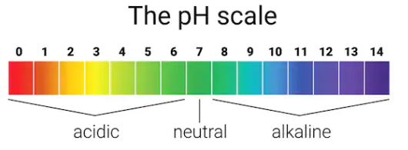
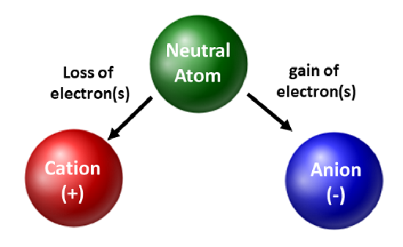
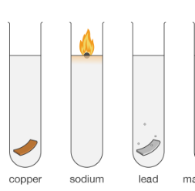
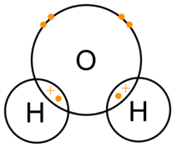
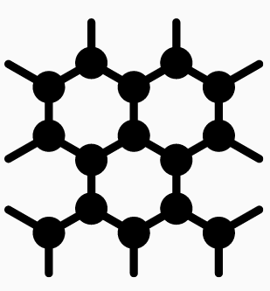
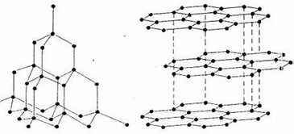
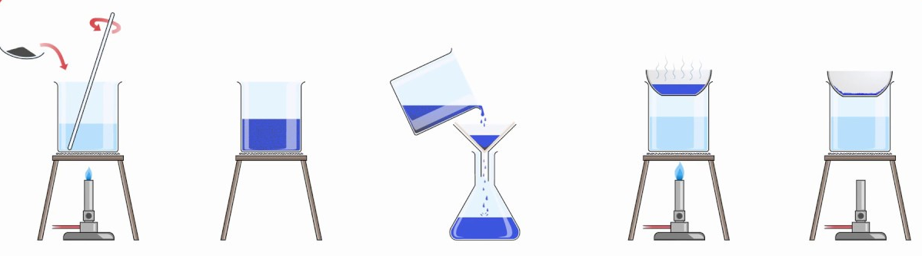



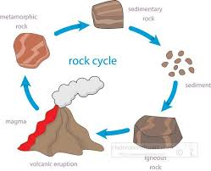
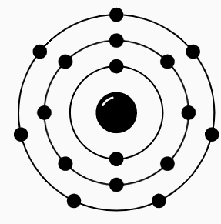
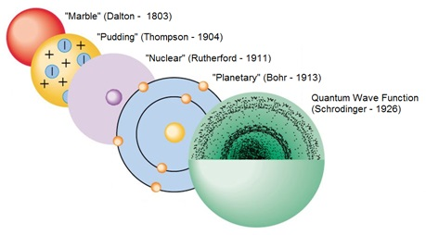
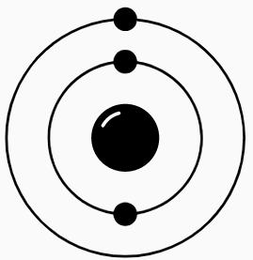



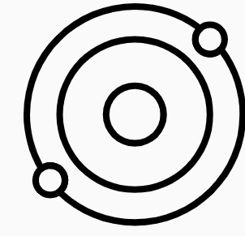
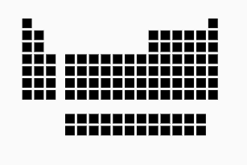

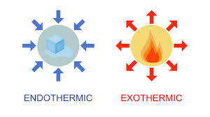

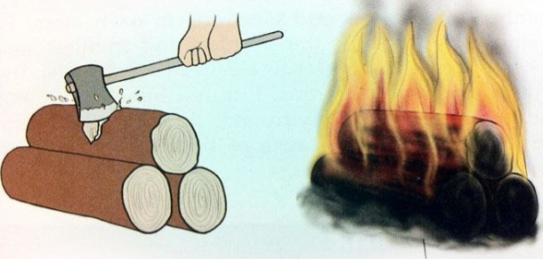

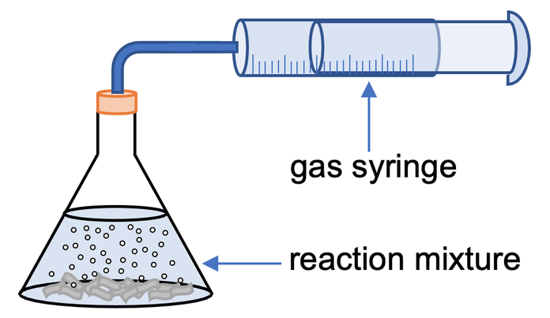
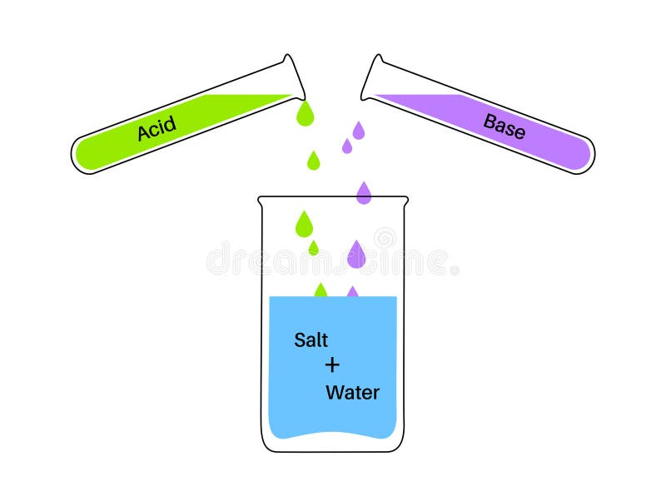

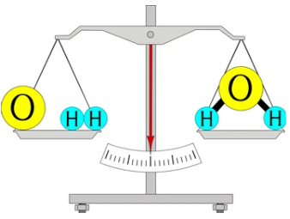
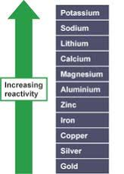
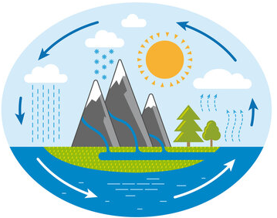
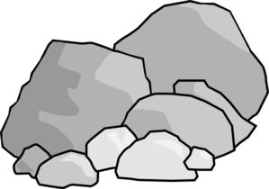
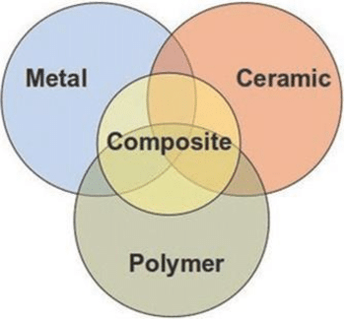
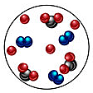
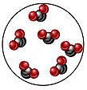
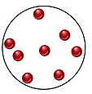
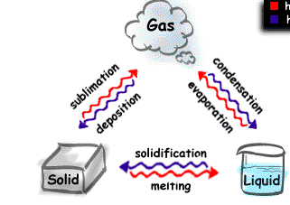
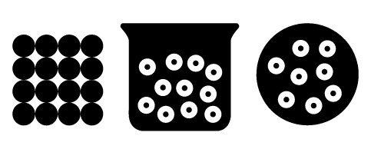
Chemistry Learning Journey
Year 7
Understanding and Applying Scientific Skills
Year 11
Writing methods
Assessing impact of scientific concepts
Understanding relationships between science and society
IDEAL
Identify, describe, explain, apply, link
Risk Assessment
Exam & Post – 16
Destination
Understanding variables
Drawing graphs and analysing graphical data
Analysis of secondary data
Modelling scientific concepts
Drawing conclusions
Applying maths to scientific concepts
Describe and explain patterns
The Greenhouse effect
Evidence for evolution of the atmosphere
Global climate change
Farming techniques- NPK Fetilisers
RP8 Analysis and purification of water samples
Formulations
Pollution
Waste-water management and potable water
Tests for
gases
9) Chemistry of the atmosphere
10) Earth’s resources
RP6 Chromatography
Carbon footprint
Haber process and revisible reactions
Life cycle assessment
Corrosion and its prevention
8) Chemical analysis
RP7 Flame tests and testing anions
RP5 Monitoring rates of reactions
Effect of temperature
Distillation
Filtration
Collision theory
11
Endothermic reactions
Exothermic reactions
Evaporation
YEAR
7) Organic
6) Rates of reaction
11
5) Energy Changes
DNA structure
and polymers
Alcohols, Esters and carboxylic acids
Alkanes and alkenes
Fractional distillation
Catalysts
Effect of concentration
Effect of pressure
RP4 neutralisation, displacement
and reactions of acids
RP3 Electrolysis
4) Chemical changes
ions
Ionic bonding
Metallic bonding
Moles
Concentration
Moles in a gas
The pH scale
2) Bonding
3) Quantitative Chem
The reactivity series
RAM and RFM
Covalent bonding
Nanoparticles
Giant Covalent structures
Avogadro’s number
Atom Economy and % yield
RP2 Titrations
RP1 making a salt
1) Atoms and the periodic table
6.02x10 ²³
Transition metals
Halogens
Bonding
The atom
Carbon Cycle
Rock Cycle
Structure of the atom
YEAR
Alkali metals
10
Foundations in Chemistry
Chemistry Earth and the Atmosphere
History of the atom
History of the atom
Periodic table
Chemical Changes
Global Warming
Fossil Fuels
The Periodic Table
Alkali Metals
YEAR
Chemical and Physical changes
Displacement reactions
Combustion reactions
Exothermic and Endothermic reactions
Rates of reaction
9
Neutralisation
Acid Rain
YEAR
Simple Chemical Reactions
Energy and Reactivity
Reactions of Acids and Bases
8
Indicators
pH Scale
Reactions with metals and acids
Rocks
Conservation of mass
Reactivity series
Water cycle
Atmosphere
Elements Compounds and Mixtures
Chromatography
Classifying Materials
Properties of
materials
Mixtures
YEAR
Separating Mixtures
Core Chemistry
7
Compounds
Elements
Changes of state
States of matter
Evaporation
Filtrations
Note: In KS4 Exact teaching order within a year may vary for combined and separate students to spread practical work between groups and allow locked papers to be used effectively as exam preparation

